Slide 1
Case Study: The Accounting Software Installation Project
Cesar A. Marrero
MGMT505 – Project Management Fundamentals
September 21, 2011
Prof. Tony L. Sines Southwestern College Professional Studies
Notes:
Welcome to this presentation. Today we will discuss the risk analysis for Peak System’s LAN Project. The individuals listed are the co-authors of this presentation.

Slide 2
Introduction
Case study: Accounting Software Installation Project
Originally started out on a positive note
In the short period of six months was in danger of failure.
Partnering approach:
Six contractors and the different company divisions
Areas to be discussed:
Current project status, constraints, associated costs, and project time-frame.
Associated project costs, return on investment, and risk assessment.
Steps that must be done for the project to be successful.
Methodology used for tracking progress.
Notes:
This paper discusses the case study of a software installation project which originally started out on a positive note, but in the short period of six months was in danger of failure. The project manager, Ms. Karin Chung, was responsible for installing accounting software throughout the company, and decided to use a partnering approach between six contractors and the different company divisions to complete the project. As a consultant hired to evaluate the project, several areas will be discussed in this paper, such as:
Current project status, constraints, associated costs, and project time-frame.
Associated project costs, return on investment, and risk assessment.
Steps that must be done for the project to be successful.
Methodology used for tracking progress.

Slide 3
What happened?
Mission:
Install accounting software
Train personnel on new software
Partnering Agreement
Six Contractor Agencies
Divisions represented by select Task Force members
Key Accounting Heads
Project started …
Notes:
Karin Chung, project manager for a large software installation project, has been overseeing the progress for the last six months. She decided that the best approach would be to implement a partnering agreement with six contracting agencies and several company divisions (represented by respective task force teams). During the formative period, the contractors and task force members provided their views on the installation project, to include potential problems and a detailed work breakdown structure. Training sessions were performed at all divisions that taught everyone about the accounting software, and each division was briefed on their respective involvement with the required software interfaces. At the end of the formative period, specific representatives from all six contractors, task force members, and key accounting executives participated in a one-day team-building workshop that emphasized collaboration and effective communication, which ended with a signed partnering agreement.

Slide 4
Two Months Later
Partnership starts to weaken
PM failed to recognize the signs
Complaints start, but no action was taken
Criticism between participants emerge
Notes:
Two months into the project there were indications that the partnership was starting to weaken. However, Karin didn't act upon these signs, which contributed to the lack of trust between the partnership members and the project manager. For example, there was a situation where a contractor ignored the concerns a task force member had presented, and after the task force member informed Karin of the encounter, she did not get involved and asked the individual to settle the issue with the contractor on their own. Criticism between certain contractors began to emerge, and the introduction of a critical compatibility issue with one of the divisions added even more bad news to the list of growing problems for the project.

Slide 5
Four Months Later
Project 2 months behind schedule
Collaboration begins to fail
PM doesn’t take control of situation
Partners begin to ignore agreement
Notes:
Four months later, the collaboration between all participants was non-existent and the project was now two months behind schedule. Karin's unwillingness to properly conduct the project during the duration of this project influenced negative attitudes that some of the partnership members began to experience. On one occasion, a contractor filed a formal letter complaining about the decisions being made by another contractor that caused schedule delays, which adversely affected their own timeline. The strongly worded letter tried to limit the contractor's liability to the project, which went against the signed partnering agreement that they produced after the team-building workshop.

Slide 6
Current Project Status
Project on hold
Constraints: individuals involved (People)
No materials or equipment constraints
No associated costs identified
No Return on Investment obtained
Notes:
The project is now on hold, awaiting the results of the upcoming meeting with the stakeholders. There are three types of resource constraints: People, Materials, and Equipment. With the current case information, it is clear that the constraints to the project are the individuals involved (people), specifically, their availability and commitment. There are no indications of materials or equipment constraints, since most of the case study text discusses the events that have influenced the project time-frame so far. Equally, the associated costs (value of money used on the project) are not mentioned anywhere in the text, so calculating the Return of Investment (ROI) is impossible to obtain.

Slide 7
Steps to take
Improve Communication
Implement a Real-Time Status Report
Determine who is in charge
PM needs to reassert her role
Re-establish the Partnering Agreement
Improved communication would take care of this
Build trust amongst participants
Implement an independent Project Review
Notes:
The primary problem was the lack of communication between the contractors, task force members, and the key division representatives. The first thing that must be established is a system of communicating the current project status, outstanding and completed tasks, and issues that need resolution (such as dependencies and compatibility problems).
Once Karin adopts and implements the Real-Time Status Report, she will take care of the second major problem that the project is facing: determining who is in charge.
In spite of having signed a partnering charter that assured they would work together, they soon forgot the spirit of the collaboration and worked in separate “spheres of responsibility”.

Slide 8
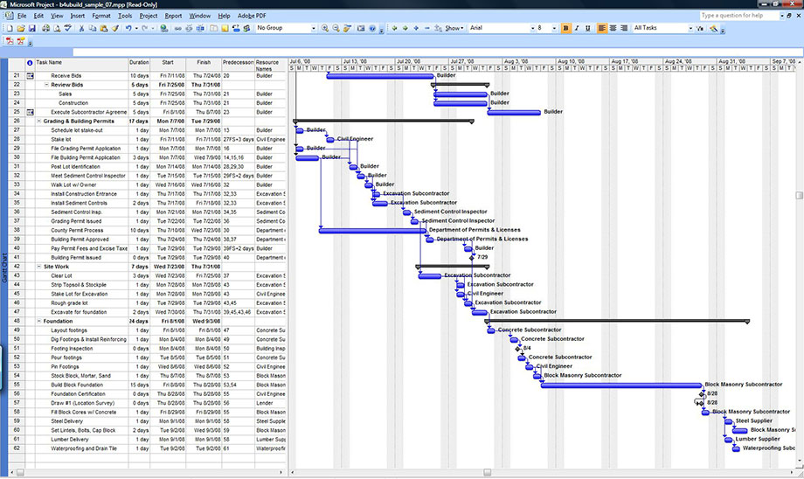
How to track progress
Gantt Charts
Notes:
Some project managers prefer to make the project's current status available using custom software that displays a simplified Tracking Gantt Chart, which only shows planned/actual dates and delays. (Campbell, 1996). However, due to the complexity of this project, there must be additional information included in the Gantt Chart, such as dependencies, outstanding tasks, and resources assigned.

Slide 9
Conclusion
Problems with the implementation of the Partnering Agreement
Solutions presented
Improve Communication
Determine who is in charge
Re-establish the Partnering Agreement
Build Trust
Track the project (Gantt Charts)
Notes:
The Accounting Installation Project is in the critical stage: the partnering agreement is about to collapse due to the lack of communication, failure to collaborate, and lack of overall control of tasks. The current project status was presented, constraints, associated costs, and project time-frame, the steps that must be done for the project to be successful, and the methodology used for tracking progress. The recommendations presented in this document will help Ms. Chung to take back control as the project manager and reinforce the partnering agreement.

